Slide 1
241
Notes:
Aquaculture is a very significant sector in the Philippines’ fisheries scene and the most dynamic ever since the deterioration of fish yield from marine fisheries starting 1976 (Aypa, 1995). The Philippines’ 0.815 million metric tons aquaculture production of fish, crustaceans and mollusks in 2013 ranked 11th in the world and a 1.16% share to the total global aquaculture production of 70.2 million metric tons (DA-BFAR, 2014). The overall value of the country’s aquaculture production of fish, crustaceans and mollusks has amounted to over 1.98 billion dollars (DA-BFAR, 2014). As compared to marine fisheries, aquaculture is a more manageable and controllable system of fish production (Aypa, 1995).
With the decline of marine fisheries, and the rise in fishpond aquaculture, some of our mangrove forests have been converted into fishponds. Although there are legal methods in converting mangrove forests into fishponds aiming at protecting and avoiding exhaustion of our coastal resources, mangrove forest cover in the Philippines has still declined substantially during the last century (Brown and Fischer 1918; DENR 1988 as cited by White, 2004). From an estimated 450,000 ha of mangroves in 1918, less than 140,000 ha exist. At present, 95% of the remaining mangroves are secondary growth and only 5% are old or primary mangroves that are mostly found in Palawan (White, 2004).
In short, what do we want to solve? Mangrove Deforestation.
How do we solve it? Converting abandoned brackish water fishpond into mangrove areas.
We may not really solve it but I’ll be presenting one way that we might be able to help.
The study was conducted in a small coastal city in the province of Negros Occidental in the Philippines. Victorias City has an area of 103.55 km.² and a coastal line of approximately 9,453 meters. Victorias City was chosen as the study site because it has a very rich mangrove cover with a total of 2.71 km.². It also has a lot of fishponds present approximately 441 individual ponds covering a total area of approximately 3.29 km.².
The lidar derivatives generated from the las files were Digital Surface Model, Digital Terrain Model, Canopy Height Model, Intensity, and Number of Returns. The images in the screen are subsets of the aforementioned layers.
We also have rugosity, slope, slope of slope and one band PCA of Digital Surface Mode, Slope of Slope and Rugosity.
For the Euclidean Distance from Mangroves: we retrieved the Mangroves shapefiles from Pada et al. (2016). The Euclidean distance layer will be used to check for the distance of the extracted fishpond shapefiles from the mangrove forest.
The fishponds were extracted using Object-based Image Analysis. Before segmentation, shapefiles for mangroves and fishponds were also added as thematic layers.
The derivatives was first checked for regions with no LiDAR data. Using the Digital Surface Model, all pixels with values less than or equal to zero were classified as No Data. Afterwards, the portion of the image with LiDAR data was segmented. Using multi-resolution segmentation we divided the image into objects. Thematic layers for River and Mangroves were also used. A scale parameter of 75 was implemented with composition of homogeneity criterion for shape of 0.4 and compactness of 0.1.
The objects were then classified to short, mid and tall. Objects with CHM values less than or equal to 0.3 was classified as short, objects values greater than 0.3 and less than or equal to 1 was classified to mid and all objects chm value greater than 1 was classified as tall.
Short objects that are within the river thematic layer was then assigned as rivers.
Afterwards, all short objects with mean slope less than or equal to 6 were classified as water and all the water objects that has an asymmetry greater than or equal to 0.6 and mean PCA greater than 63 was assigned as dikes.
All inland water was classified as depressions or candidates for fishponds. These candidates went through a cleanup process. The cleanup methodology will depend on the area however some noticeable layers can be used such as mean DTM, mean slope of slope and area. After cleaning up, all depressions were reclassified into fishponds.
The abandoned fishpond were then classified from the extracted fishpond. All fishponds with mean slope of slope greater than 40 was assigned as candidates. Since most vegetated fishponds have higher slope of slope values due to some trees and other objects inside the fishpond box.
All objects with mean CHM less than 0.022 was removed from the candidates. Objects with rectangular fit less than 0.4 was also removed. Objects with length over width value greater than 6.37 was also removed. Furthermore, the final objects that were classified as abandoned were exported with their mean Euclidean distance for mangroves value.
The study generated a shapefile that contains possible reversion sites for mangroves. All of the classified abandoned fishpond sites contained vegetation when checked with the existing Orthographic photograph with 0.5 m resolution. From the 441 extracted fishponds 57 were classified as abandoned. From the total fishponds area of 3.29 km.² it was found out that 0.45 km.² of it was already vegetated resulting into 13% of the total fishpond area to be vegetated.
If these sites will be used for mangrove reversion efforts, the Euclidean distance of the sites from mangroves will be very helpful. The green areas in the image above are nearer to the mangroves while the red ones are farther.
In conclusion, the fishponds were extracted from LiDAR data using object based image analysis and was further classified as to which is abandoned by checking the vegetation through elevation models. The features that were most helpful in delineating the abandoned fishponds from the functional fishponds were mean slope of slope, mean canopy height model, rectangular fit and length/width ratio. The process resulted in successfully identifying 57 fishponds that were abandoned based on the criterions stated in the methodology of this study. Furthermore, the Euclidean distance layer is useful in identifying which features are closest to the existing mangroves. Through the workflow presented in this study, mangrove reversion sites were successfully identified by using LiDAR data.
For further studies, the fishpond lease agreements could be used as a thematic layer so as to identify illegal fishponds and reclaiming them for mangrove reversion sites. Tidal zones shall also be considered in creating a suitability analysis. There are a lot of possible factors that shall be included in the study but due to lack of data, time and financial capability, these weren’t acquired. However, initial steps for using the high resolution LiDAR data are already presented in the study thus it will be easier to replicate once more data for other factors are acquired.

Slide 2

University of the Philippines Cebu
Phil – LiDAR 2
Extracting Abandoned Brackish Water Fishpond From LiDAR Data For Mangrove Reversion Suitability Analysis
M. A. Cabanlit
Research Associate

Slide 3
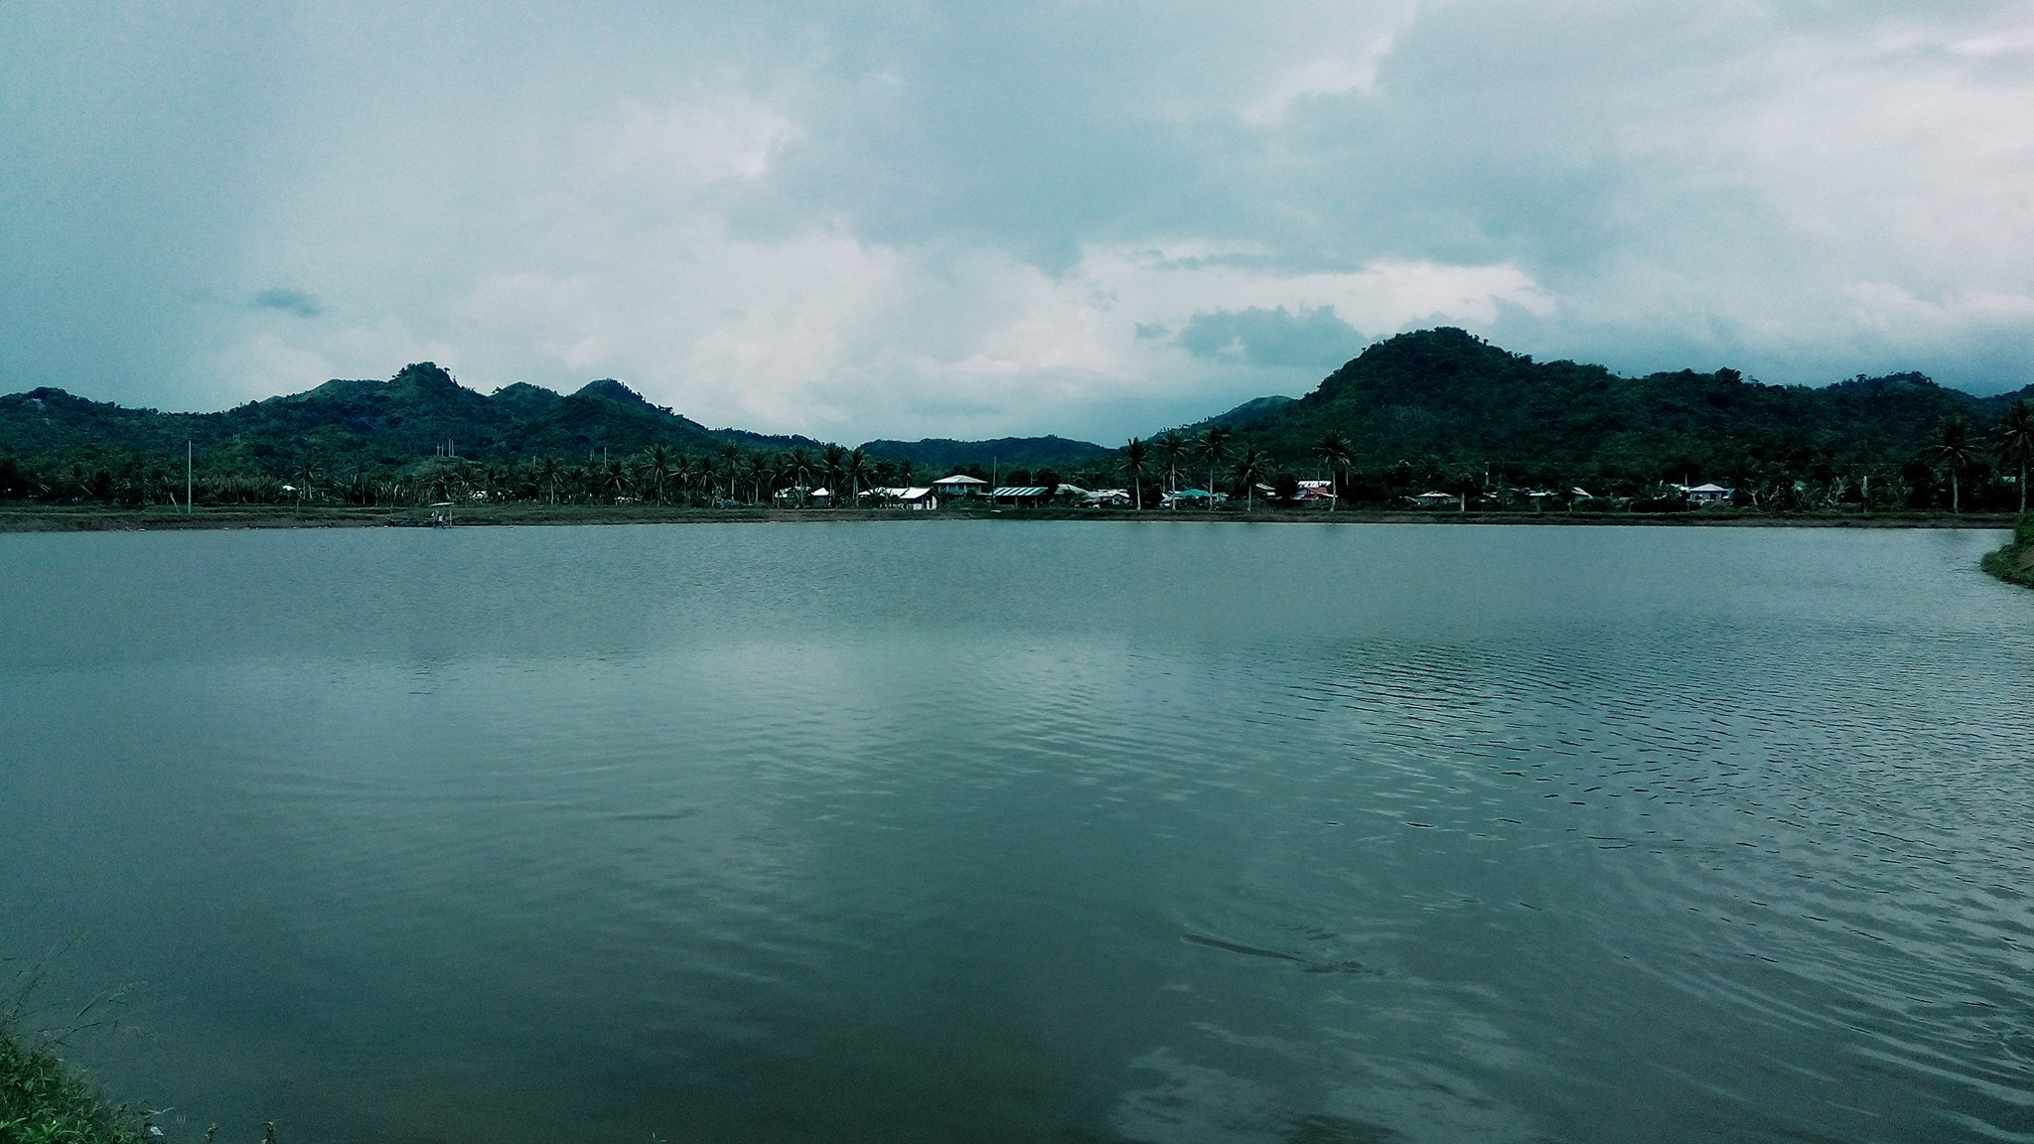
Contents
01
Introduction
02
Methodology
03
Results
04
Conclusion
05
Recommendations
2

Slide 4
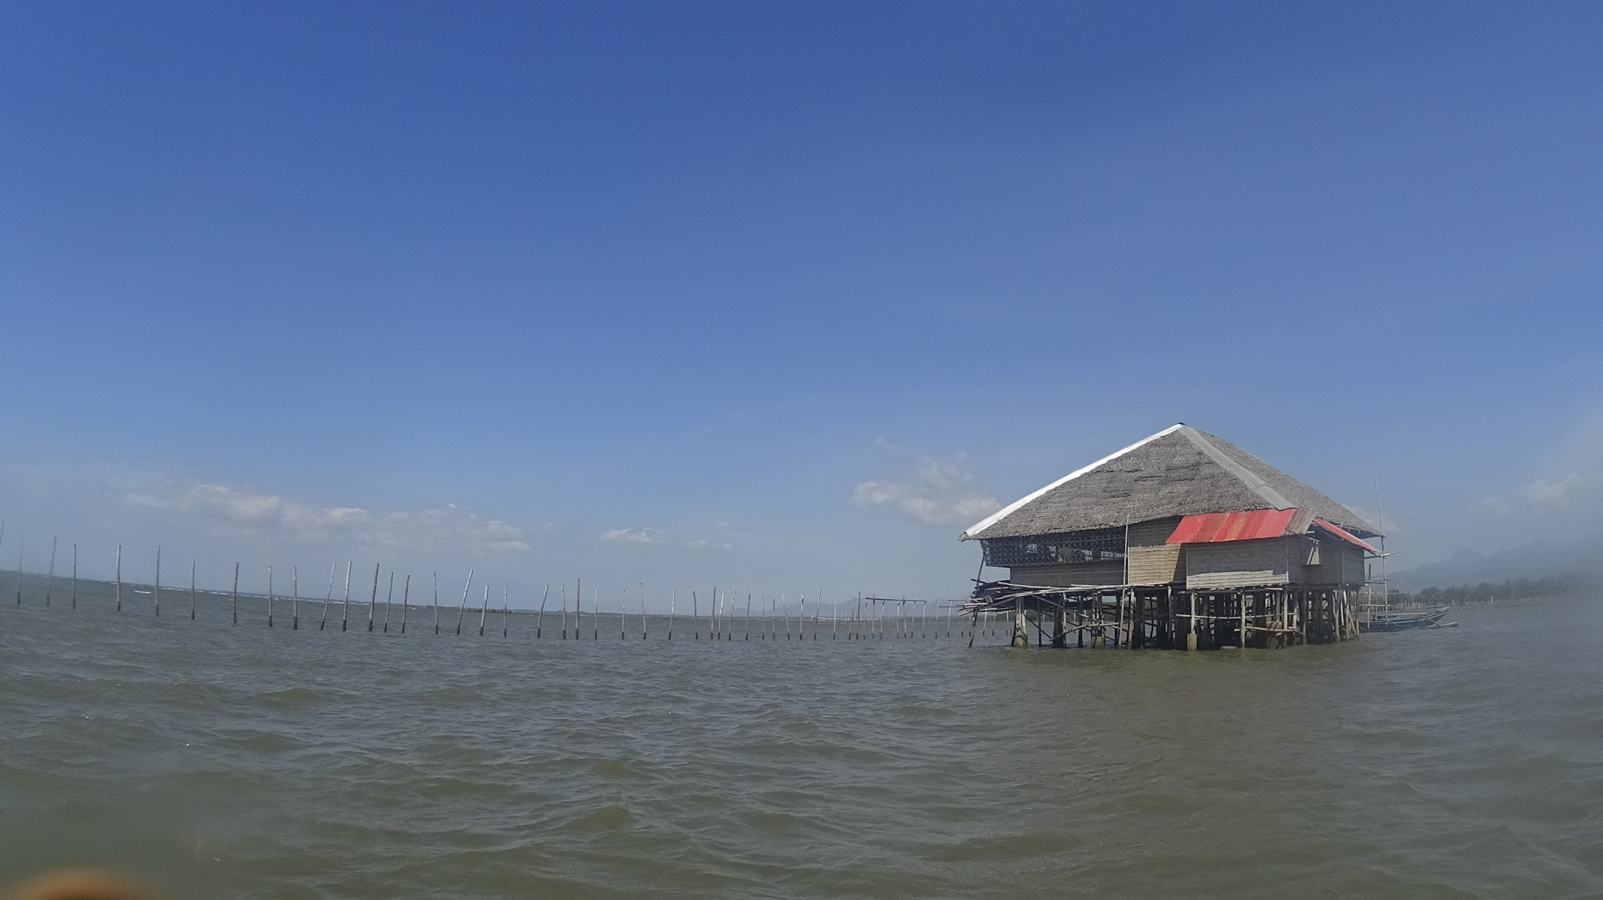
Aquaculture Production in the PH
In Metric Tons Per Year
3

Slide 5
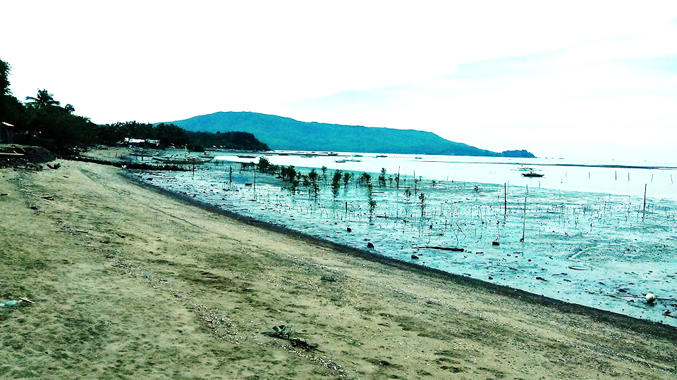
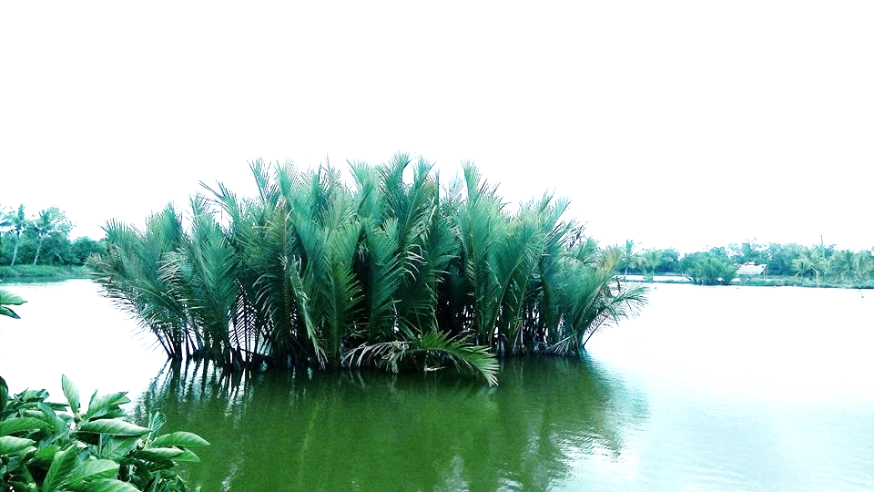
Results of Seafront Mangrove Planting Efforts in Barotac Viejo, Iloilo, Philippines
Few Nypa fruticans left after area was converted to a fishpond in Pontevedra, Capiz, Philippines

Slide 6
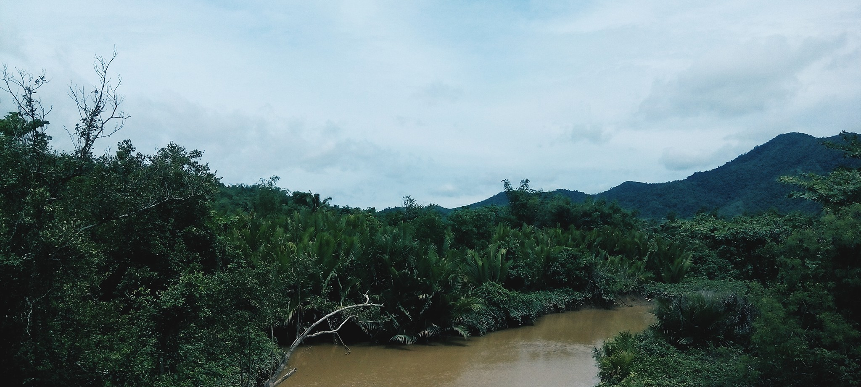
Mangrove
Deforestation
What do we want to solve?
Introduction

Slide 7
Using Abandoned Brackish Water Fishpond For Mangrove Reversion
How do we solve it?
Introduction

Slide 8
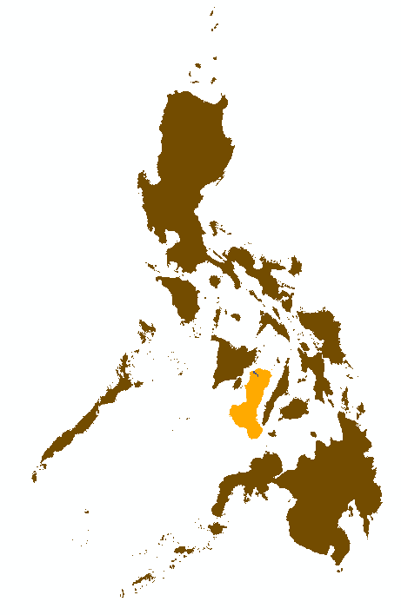
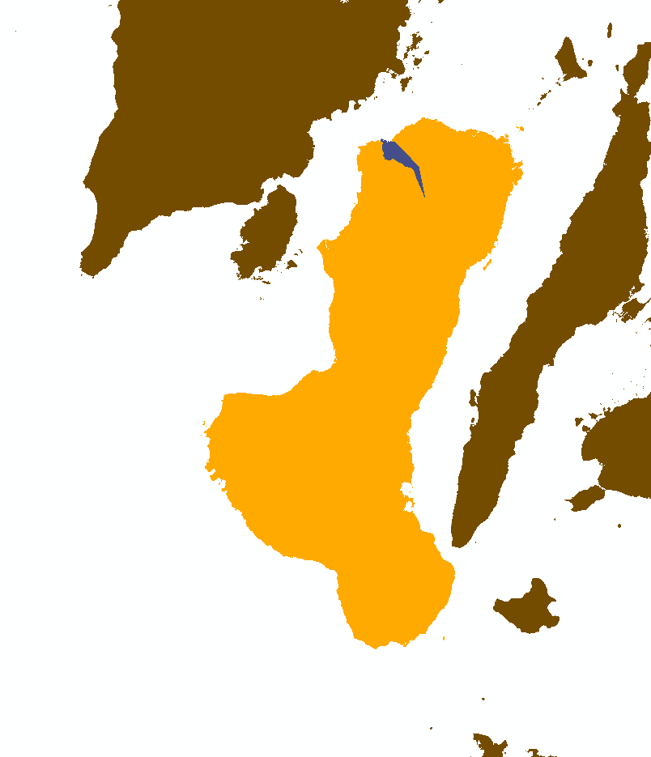

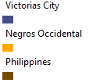
Study Site
City of Victorias
7

Slide 9
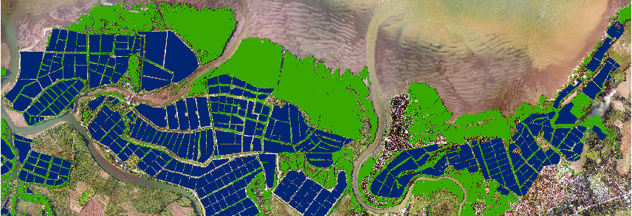
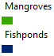
Study Site
City of Victorias
8

Slide 10
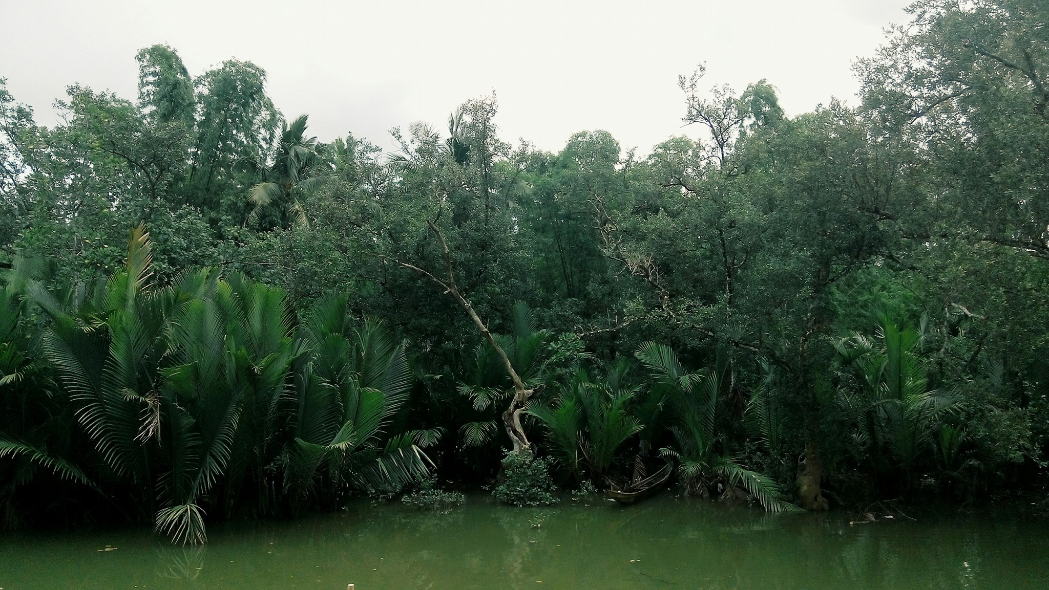
Methodology

Slide 11
Layers Involved

Slide 12
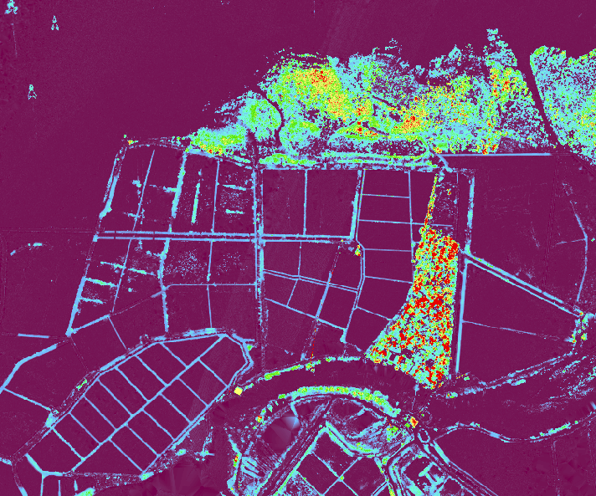
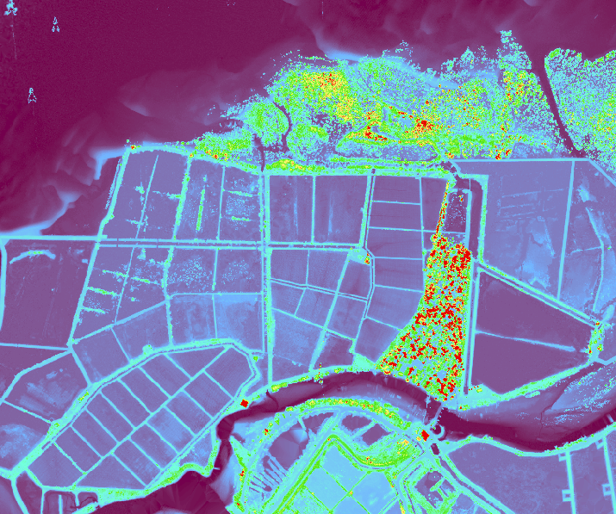
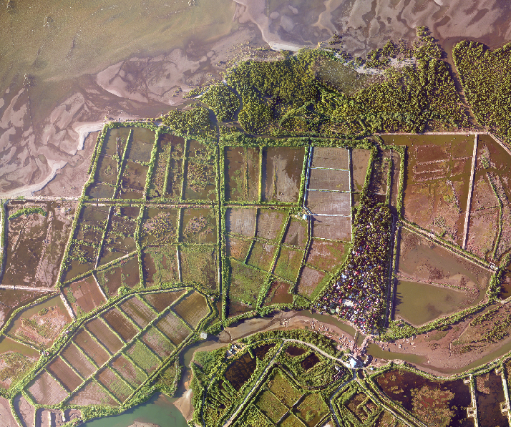
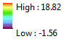
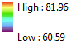
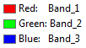
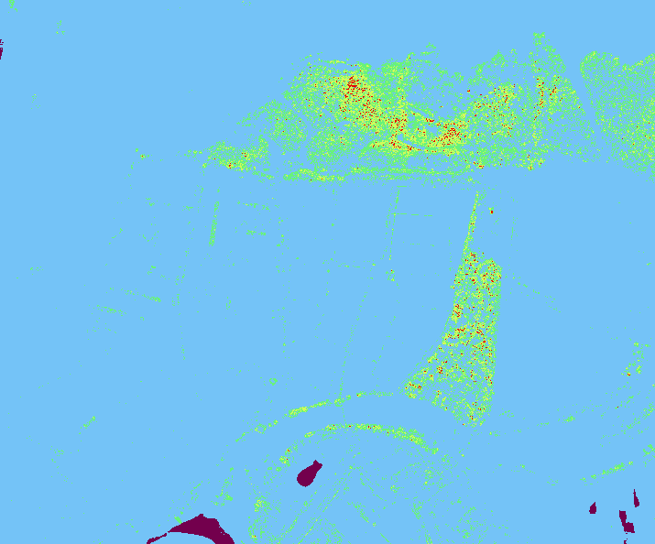
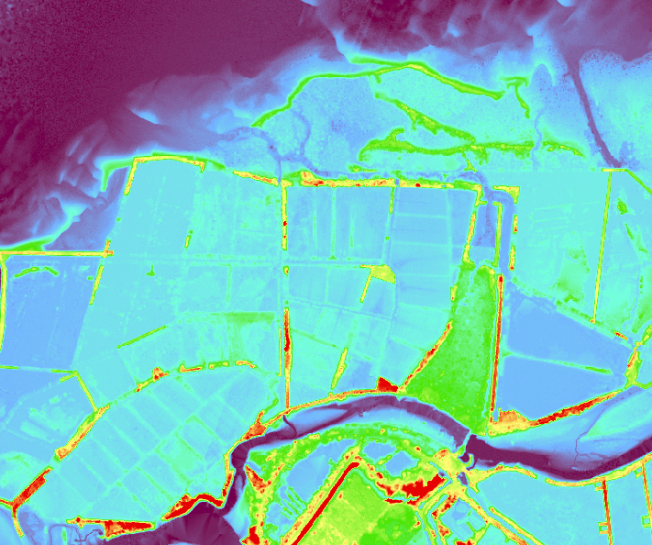
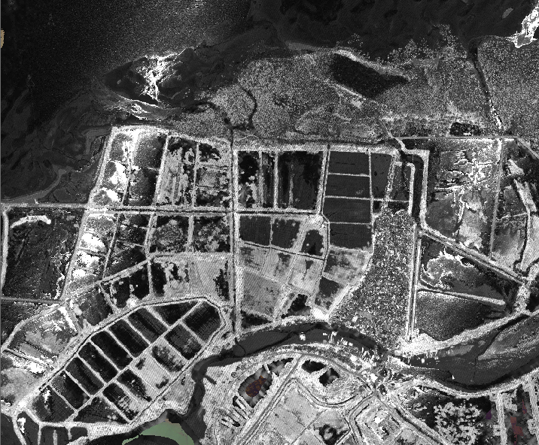
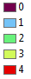
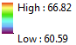
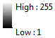
Layers Involved
From Las Files
Canopy Height Model
Digital Surface Model
Orthophoto
Number of Returns
Digital Terrain Model
Intensity
11

Slide 13
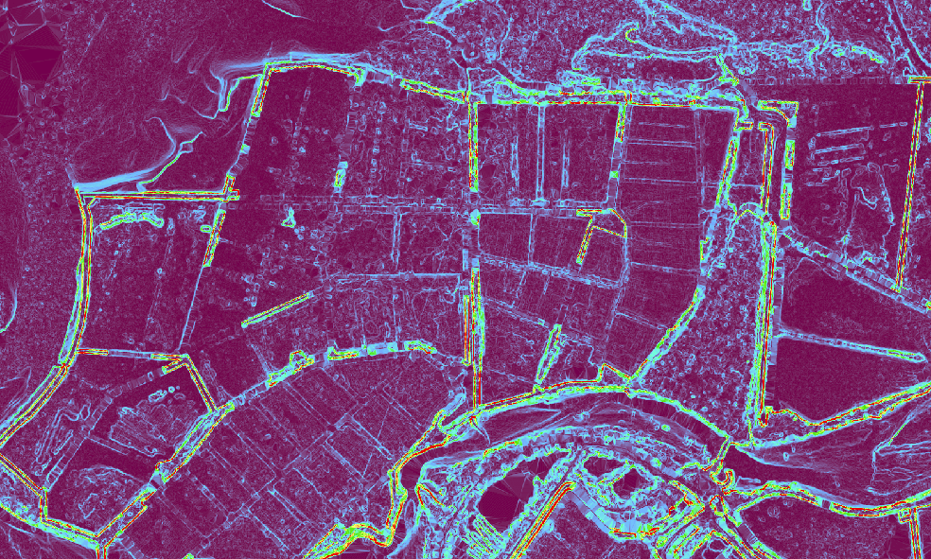
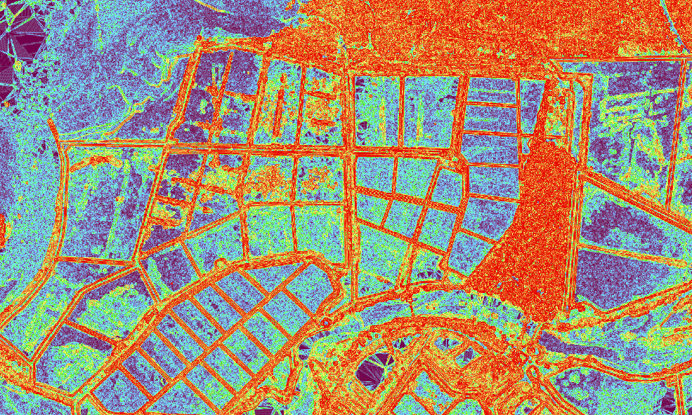
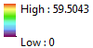
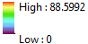
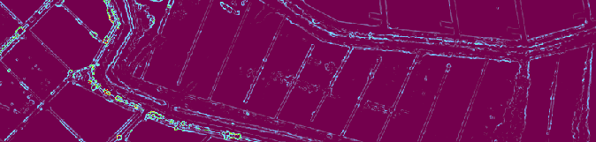
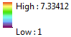
Layers Involved
From Rasters (from las)
Slope
Slope of Slope
Rugosity
12

Slide 14
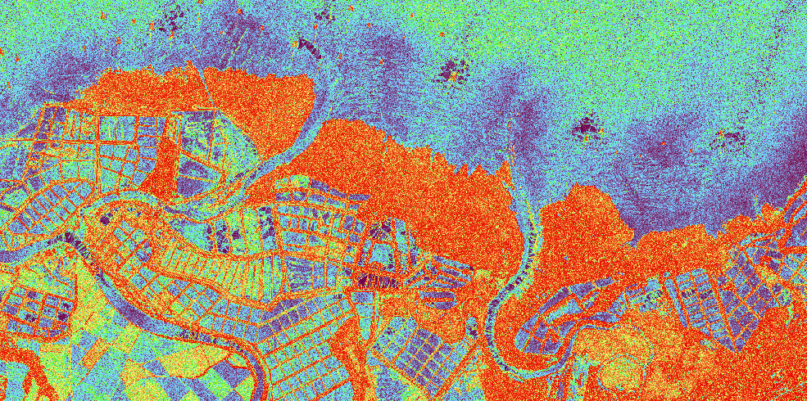
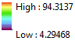
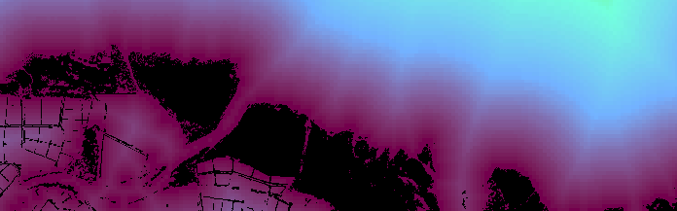

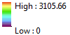
Layers Involved
From Rasters (from las)
Principal Component Analysis (1 Band only)
Euclidean Distance Raster
14

Slide 15
Image Processing

Slide 16
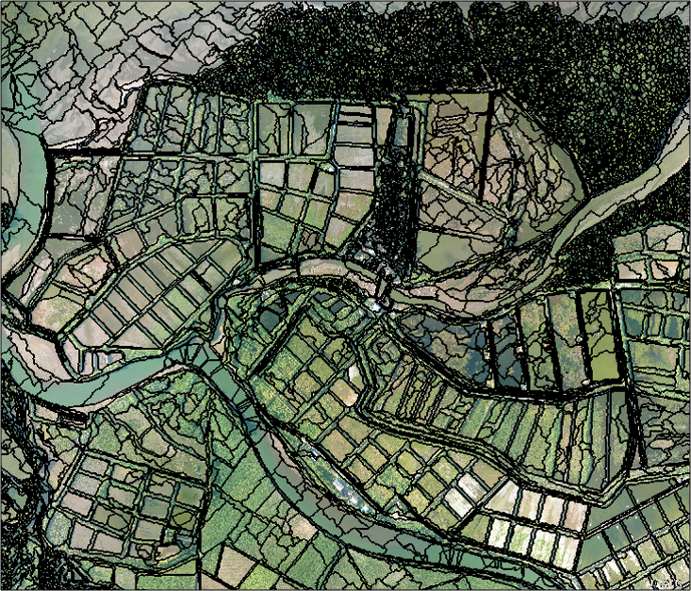
15
Segmentation

Slide 17
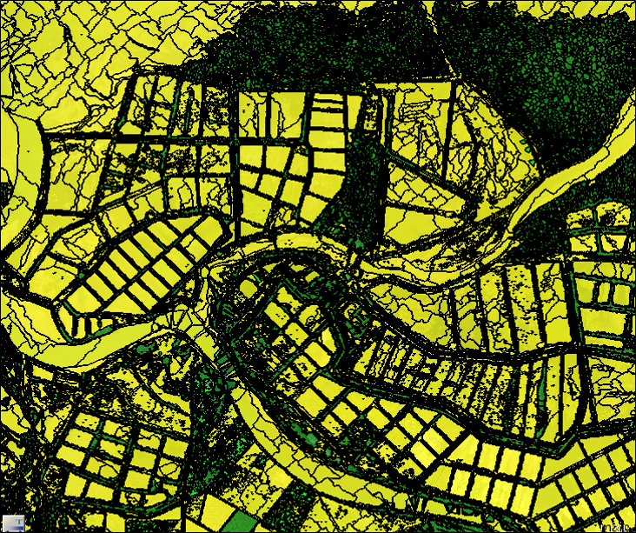
Short, Mid, and Tall Classification

Slide 18
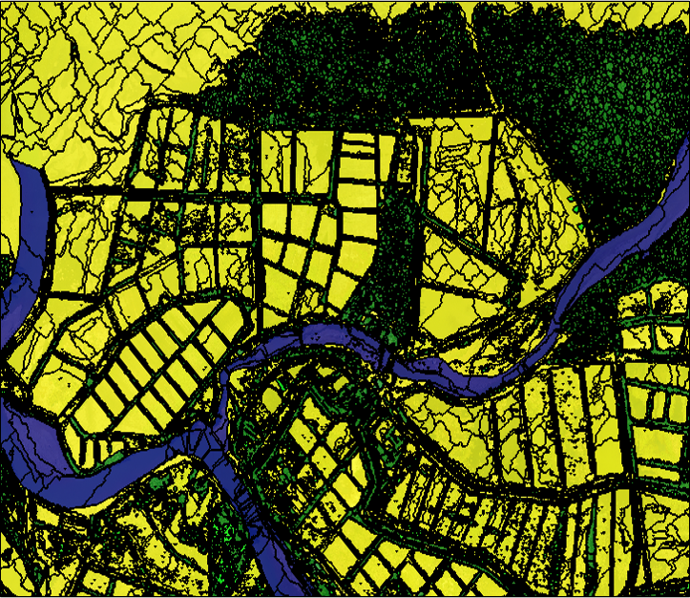
River Shapefile

Slide 19
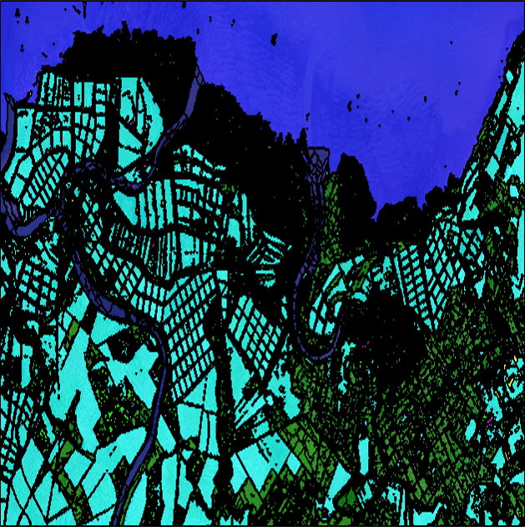
Assign Class: Fish Pond

Slide 20
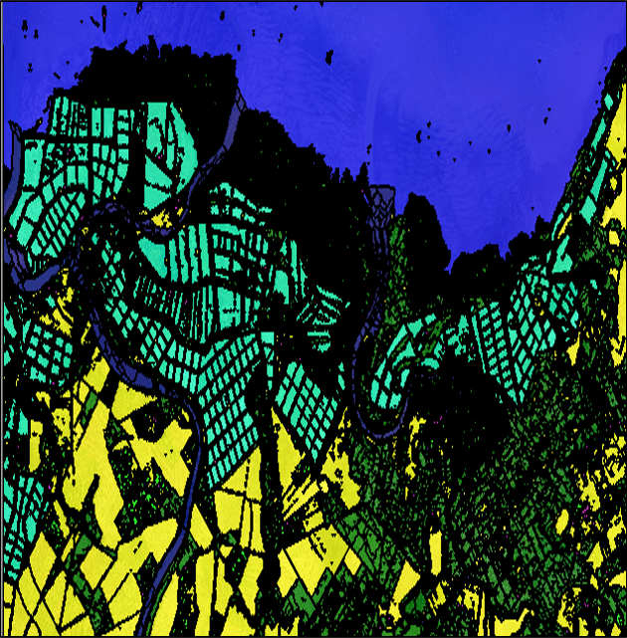
Cleanup

Slide 21
Abandoned
Fish Pond
Classification

Slide 22
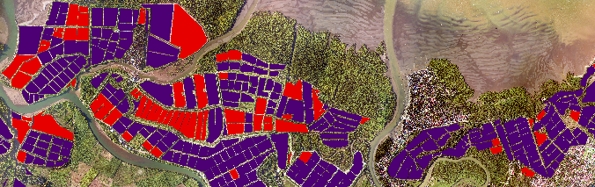
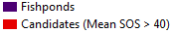
Abandoned Fish Pond Classification
Mean SOS
21

Slide 23
Results

Slide 24
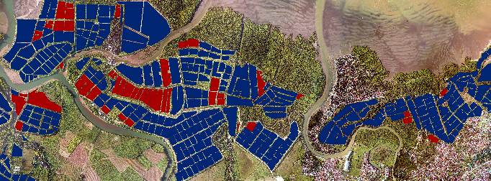

Results
and Discussion
23

Slide 25
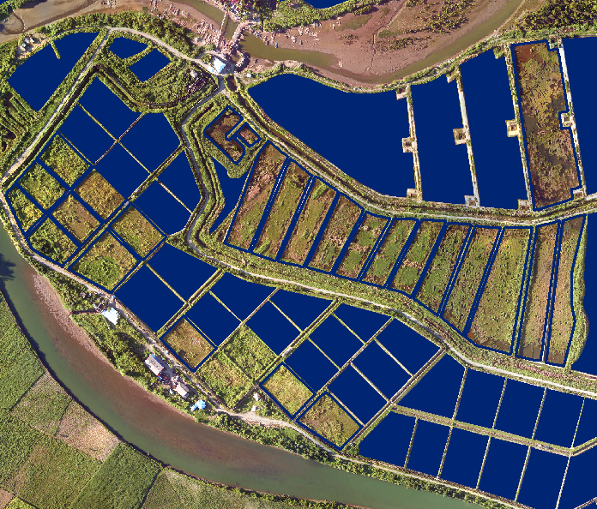
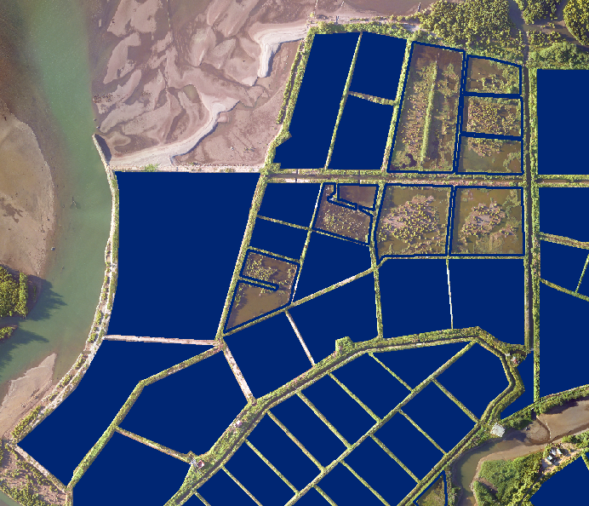
Results
and Discussion
24

Slide 26
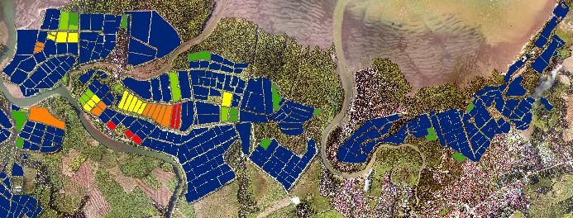
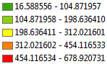
Results
and Discussion
5

Slide 27
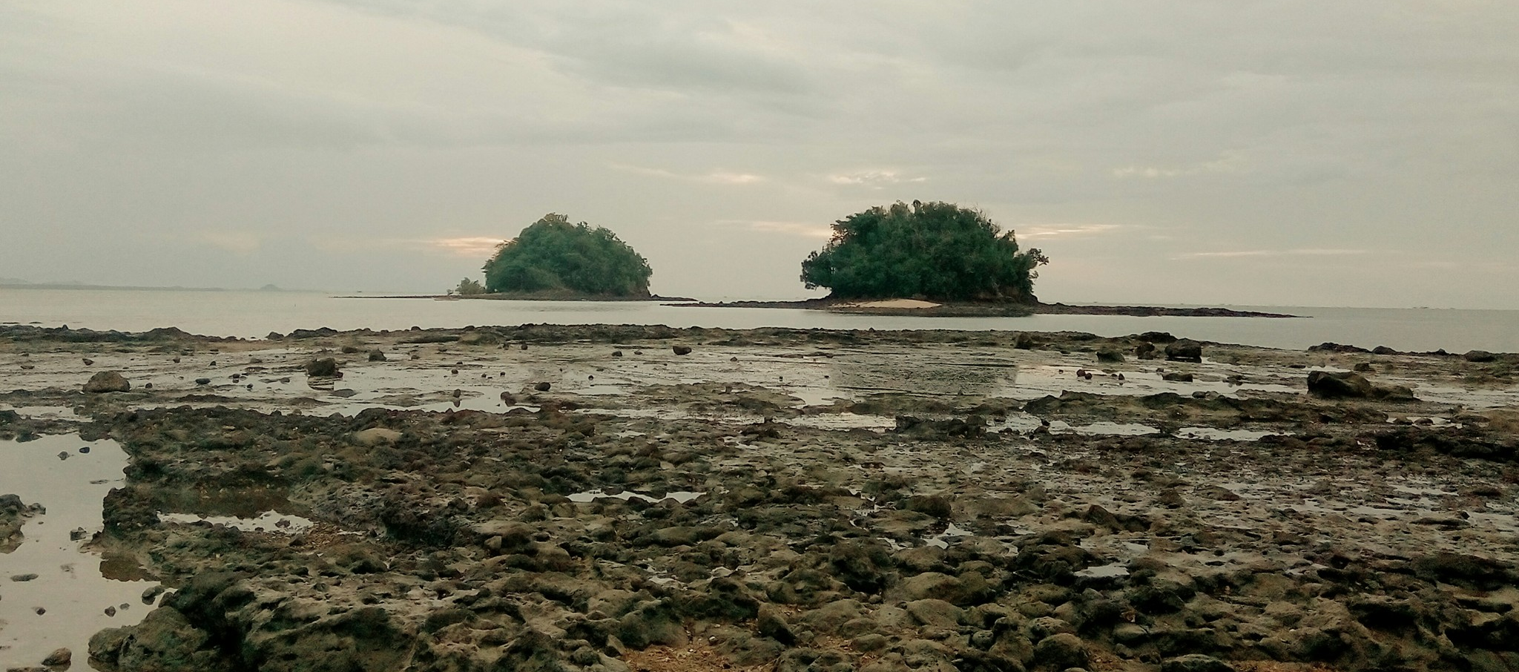
Conclusion
The fishponds were extracted from LiDAR data using object based image analysis and was further classified as to which is abandoned by checking the vegetation through elevation models.

Slide 28
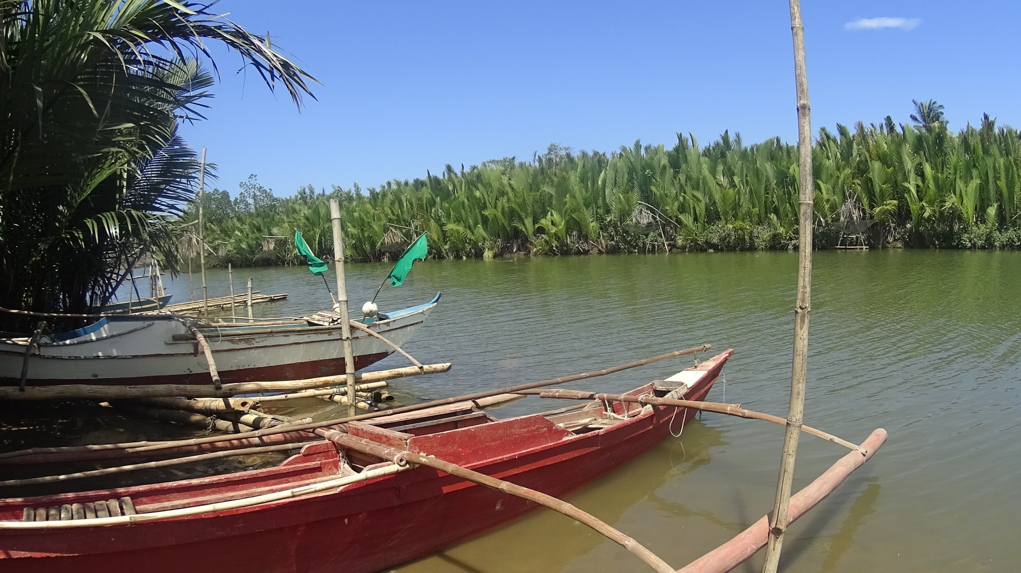
Recommendations
01
FLAs shall be considered
02
Tidal Zones shall also be considered
03
Ph shall also be considered
04
Consider other biological factors
05
Create accuracy assessment
27

Slide 29
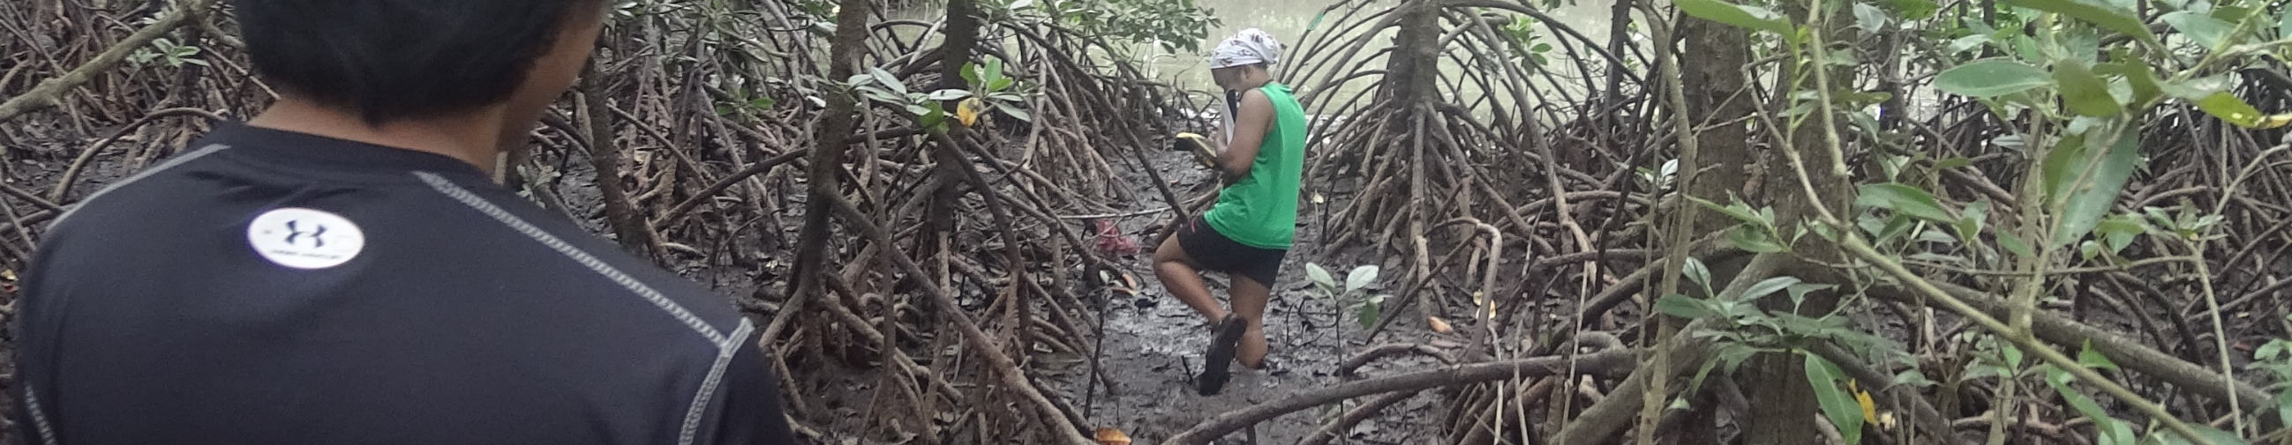






Acknowledgements
I would like to thank the following:
Department of
Science and Technology
Asian Conference
on Remote Sensing
Funding Agency
Secretariat
Deparment of
Science and Technology –
The Philippine Council for Industry, Energy, and Emerging Technology Research nad Development
Phil-LiDAR 2
Project
University of the Philippines
Cebu
Monitoring Agency
Asian Associate
On Remote Sensing
28

Slide 30
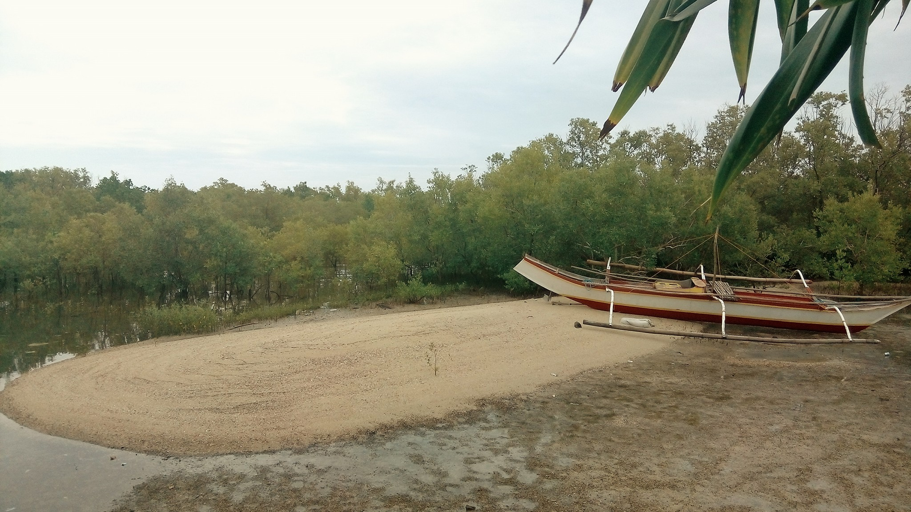
Questions?
https://ph.linkedin.com/in/mcabanlit
mharkiecabanlit@gmail.com

Slide 31
Thank you!

